Slide 1

Selenium End-to-End Automation Framework
Presented by: Vijender Raika
1
ISTQB Certified
Software Test Engineer
2
2.8+ Years
Industry Experience

Slide 2

Framework Purpose: Real-Time Value
Our automation framework is designed to deliver immediate and tangible benefits, streamlining testing processes and enhancing product quality.
Automate Suites
Reduce Effort & Time
Efficiently handle regression and sanity test suites.
Significantly cut down manual testing efforts and execution cycles.
Ensure Stable Releases
Comprehensive Validation
Guarantee reliability and stability for every product release.
Support UI, API, and Database validation for full coverage.

Slide 3
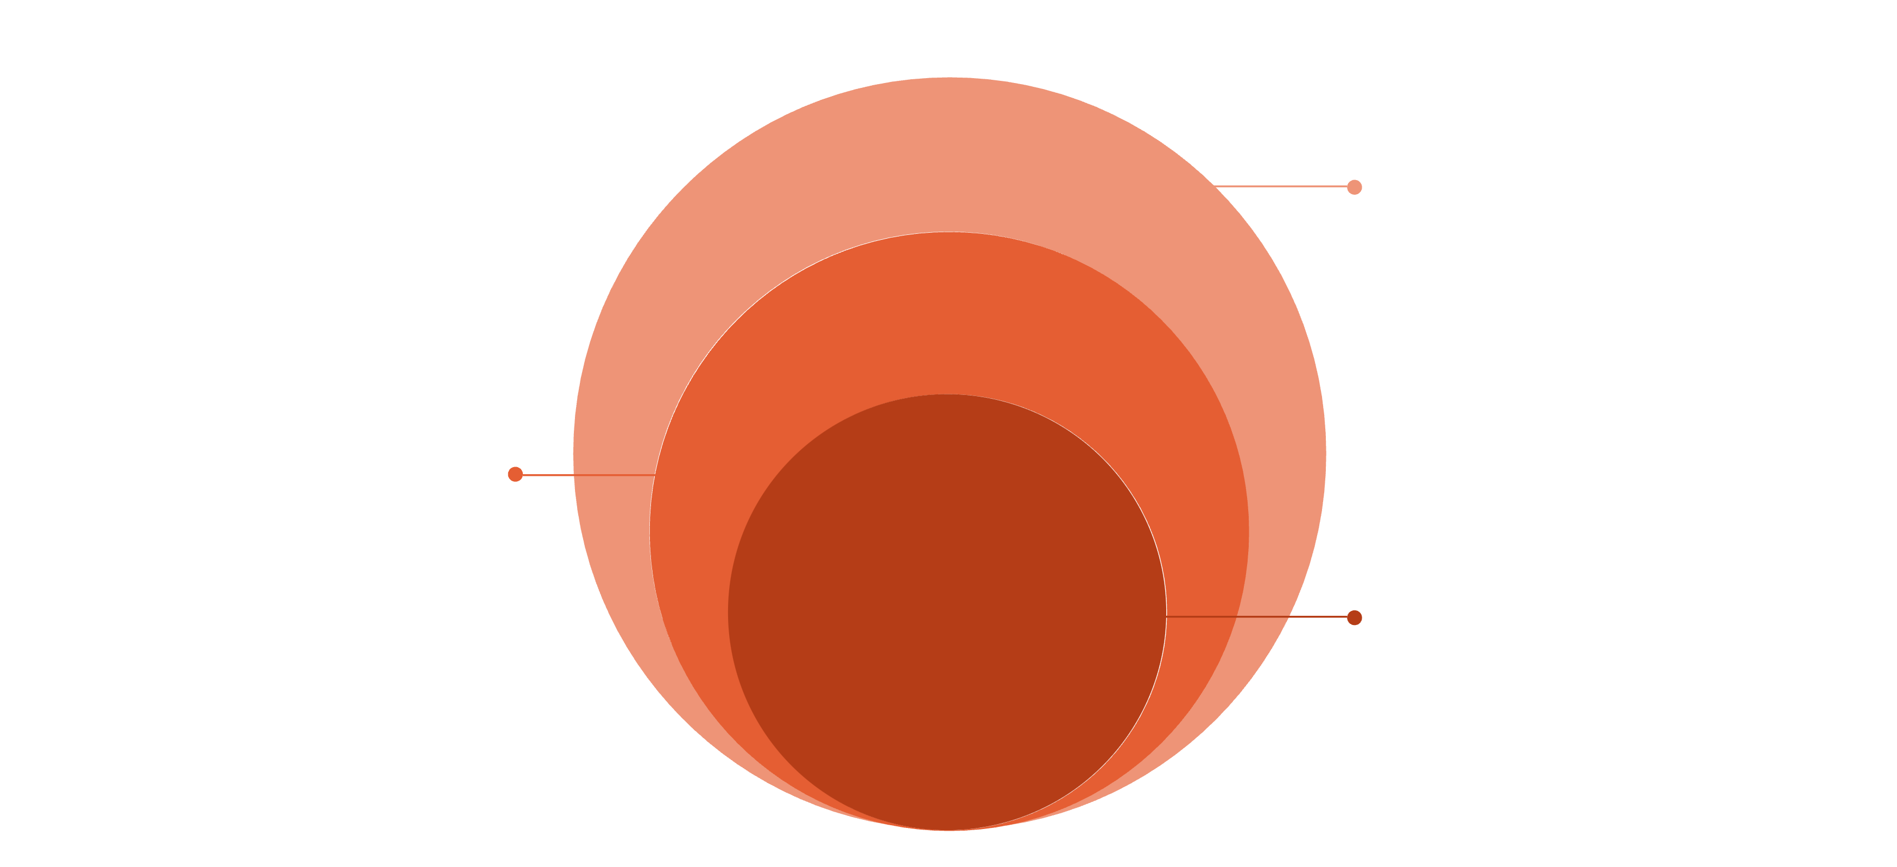
Framework Architecture
Test & Utilities
Test cases, helpers, and reports
Page Layer
UI page objects and selectors
Core Base
Environment, config, and drivers
This structured architecture ensures maintainability, scalability, and robust test coverage across all project aspects.

Slide 4
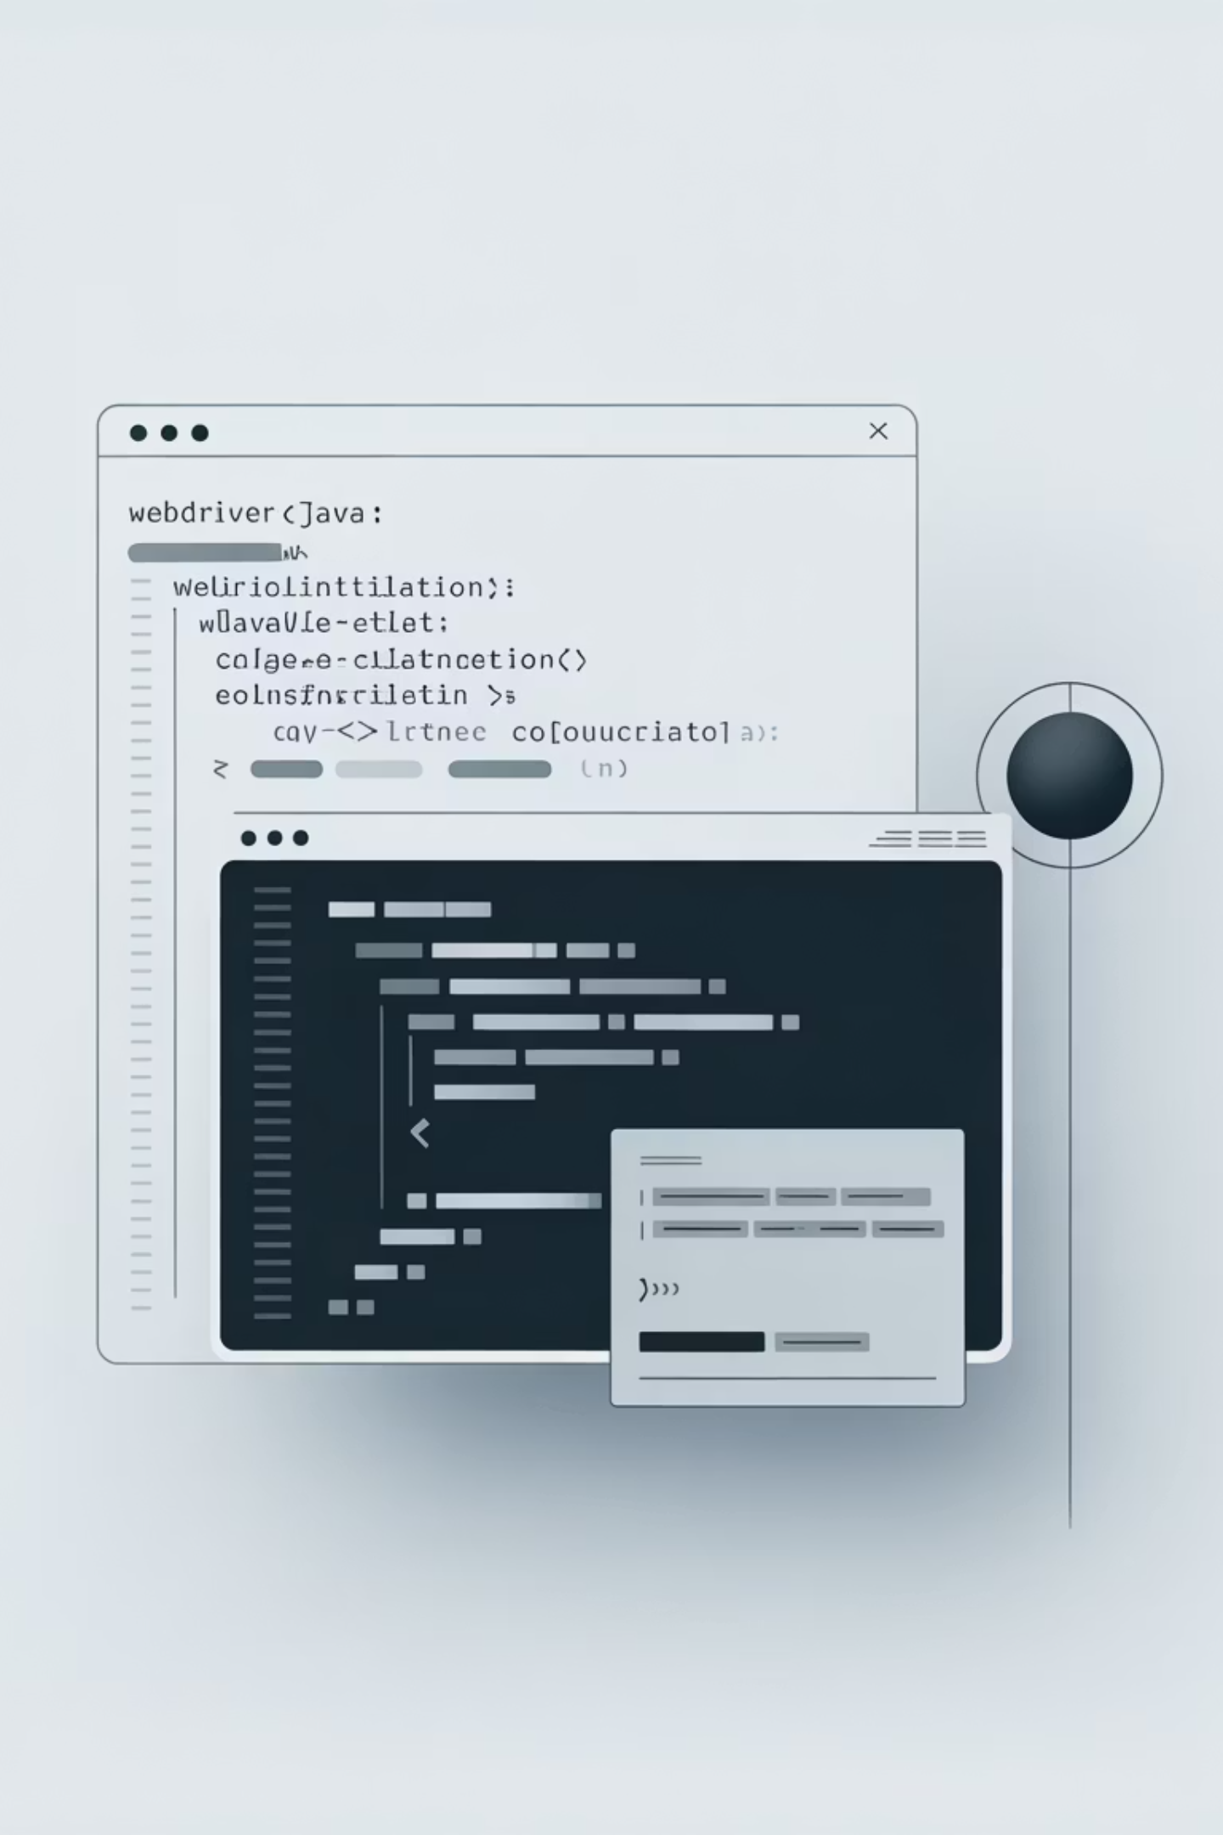
Base Class: Driver Setup
The Base Class is the foundation of our test execution, managing the browser and environment lifecycle.
Browser initialization for consistent test environments.
Environment configuration for different stages (dev, staging, prod).
WebDriver lifecycle management, including setup and teardown.
WebDriver driver; @BeforeMethod setup() { /* ... browser setup ... */ }

Slide 5
Page Class: Page Object Model
Embracing the Page Object Model (POM) pattern for maintainable and readable tests.
Centralizes UI locators for easy updates.
Encapsulates page-specific actions and interactions.
Promotes reusability and reduces code duplication.
Strictly avoids assertions to keep page objects clean and focused.
By username = By.id("user");
public void login(String user, String pass) {
driver.findElement(username).sendKeys(user);
driver.findElement(password).sendKeys(pass);
driver.findElement(loginButton).click();
}

Slide 6
Test Class: Leveraging TestNG
TestNG provides powerful features for test execution, reporting, and parallel testing.
Defines test scenarios for specific functionalities.
Includes assertions and validations to verify expected outcomes.
Supports annotations for test configuration and execution flow.
Enables grouping, prioritization, and dependency management.
@Testpublic void validateLogin() {loginPage.login("user", "pass");Assert.assertTrue(dashboardPage.isDisplayed());}

Slide 7

Data-Driven Testing with Apache POI
Enhancing test coverage and flexibility by separating test data from test logic.
Read Data from Excel
Multiple Scenarios
Utilize Apache POI to extract test data from Excel spreadsheets.
Execute the same test logic with diverse data sets for comprehensive coverage.
Reduced Hardcoding
Minimize hardcoded values, making tests more adaptable and maintainable.
Object[][] testData = DataReader.getData("LoginData.xlsx", "Sheet1");

Slide 8
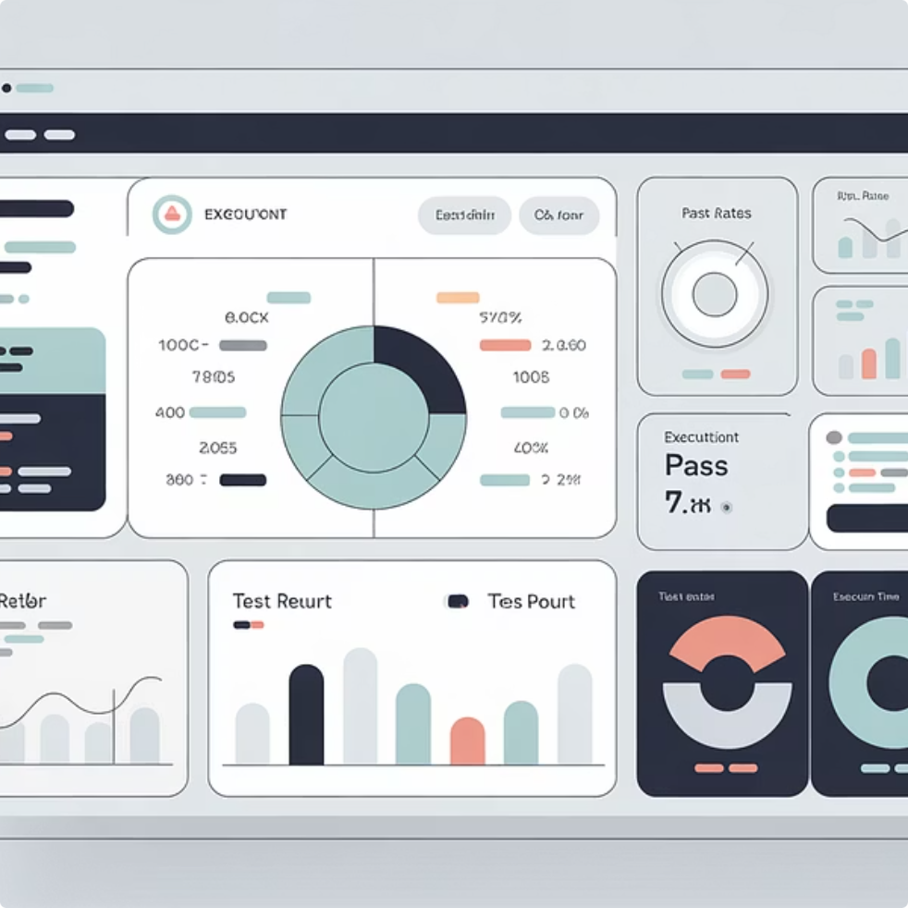
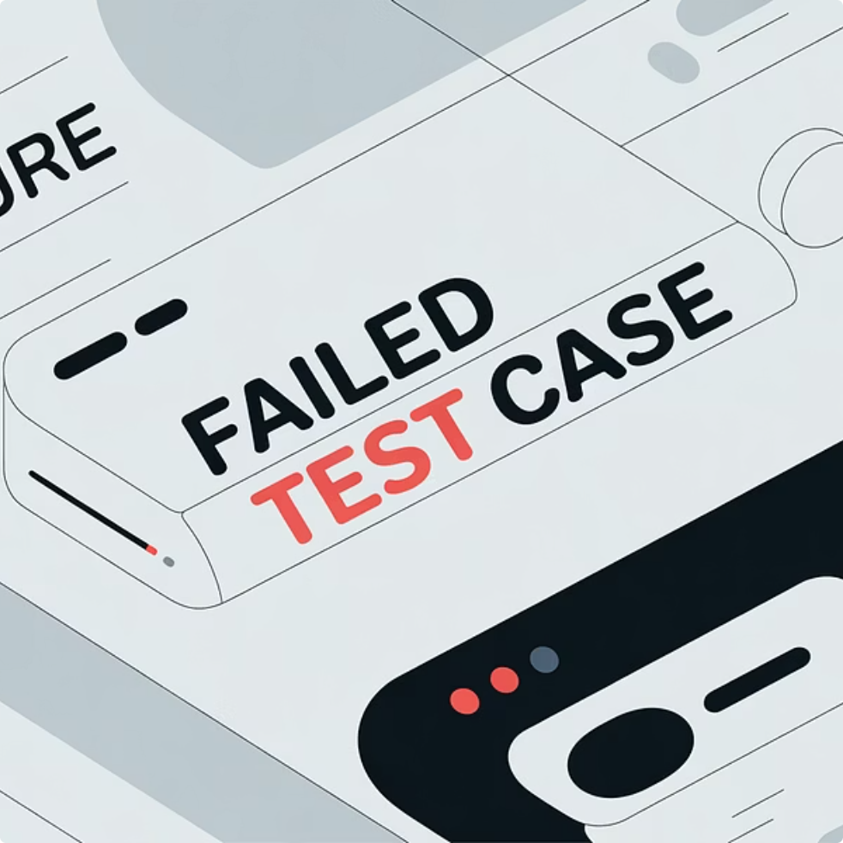

Comprehensive Reporting: Extent & Allure
Detailed and visually appealing reports are crucial for tracking test execution and defect analysis.
Step-wise Logs
Screenshot on Failure
Test Summary Dashboard
Provides granular execution logs for every test step, aiding in quick debugging.
Automatically captures screenshots for failed tests, offering immediate visual context.
Offers an overview of test runs, pass/fail rates, and trend analysis.

Slide 9
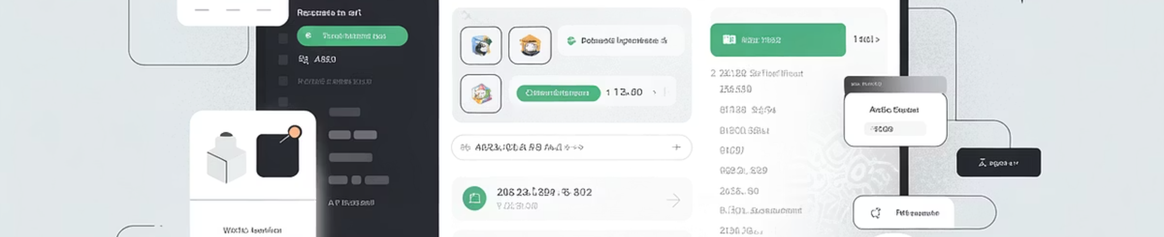
API Testing Integration
Ensuring the robustness of the backend before UI interactions.
Postman is integrated for efficient API validation.
Validates critical components like status codes and response body structure.
API tests are executed prior to UI validation, guaranteeing backend stability.
This "shift-left" approach identifies issues earlier in the development cycle.

Slide 10

Database Testing
Verifying data integrity and consistency between the UI and the database.
SQL queries are executed to retrieve and manipulate database records.
Compares UI displayed data against database values to ensure accuracy.
Crucial for maintaining data consistency across the application.
Primarily used in contract and reporting modules where data accuracy is paramount.

